Slide 1
Operating system between user and hardware

Slide 2
Operating system between user and hardware
As mentioned, an operating system is called an intermediary agent between the user and the computer hardware, that:
Manages the computer’s resources (hardware, abstract resources, software)
Is a resource allocator;
Is also used to control programs to prevent errors;
“interrupt” manage. The signals that are sent by devices to the CPU are called interrupts.

Slide 3
Operating system between user and hardware
These interrupts are usually input/output devices. They signal the CPU to halt its current activities and execute the appropriate part of the operating system. There are three types of interrupts:
Hardware interrupts
Software interrupts
Traps (Errors)

Slide 4
Operating system between user and hardware
1. Hardware Interrupt: The interrupts that are generated by hardware devices to indicate that they need some attention from the OS. For example, they have just completed a task that the operating system previously requested, such as transferring data between the hard drive and memory;
2. Software Interrupts: The interrupts that are generated by programs when they want to request a system call to be performed by the operating system;
3. Traps: Traps are the signals that are generated by the CPU itself to indicate that some error or condition occurred for which assistance from the operating system is needed.

Slide 5
Operating system between user and hardware
The way the user is interacting or using the operating system is called the interface.
Operating systems normally have two types of interface, i.e., (i) a character user interface (CUI) and (ii) a graphical user interface (GUI) (windows, icons, menu bars, pointing devices, and graphics).

Slide 6
Operating system functions
Prepares a list of all authorized user
Maintains a list of all resources in the system
Constructs a list of all processes running in the system
Creates processes
Initiates the execution of programs
Provides controlled access of resources to the programs
Performs CPU scheduling
Allocates main memory to the processes
Allocates resources to the processes
Provides inter-process communication
Provides security and protection

Slide 7
TYPES OF OPERATING SYSTEMS

Slide 8
The operating system Zoo
Mainframe operating systems
Server operating systems
Multiprocessor operating systems
Personal computer operating systems
Handheld Computer operating systems
Embedded operating systems
Sensor node operating systems
Real-time operating systems
Smart card operating systems

Slide 9
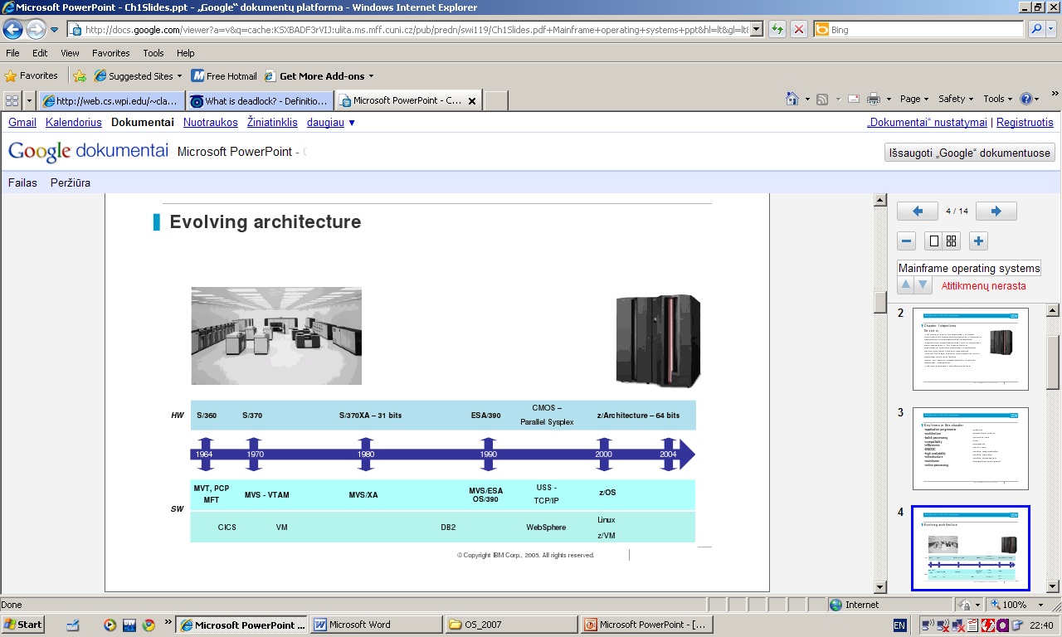
Mainframe operating systems
A mainframe is a computing system that businesses
use to host the commercial databases, transaction servers, and applications that require a greater degree of security and availability than is commonly found on smaller-scale machines.
The power of a mainframe provides computing speed and capacity, enabling it to perform high volumes of processing.
The mainframe can process a mixed workload of jobs from different time zones and of different types.

Slide 10
Mainframe operating systems
Who uses mainframes?
• Most Fortune 1000 companies use a mainframe environment
• 60% of all data available on the Internet is stored on mainframe computers
Why mainframes?
• Large-scale transaction processing (Thousands of transactions per second)
Support thousands of users and application programs
Simultaneously accessing resources
Terabytes of information in databases
Large-bandwidth communications
There are more CICS transactions processed daily than Web pages served

Slide 11
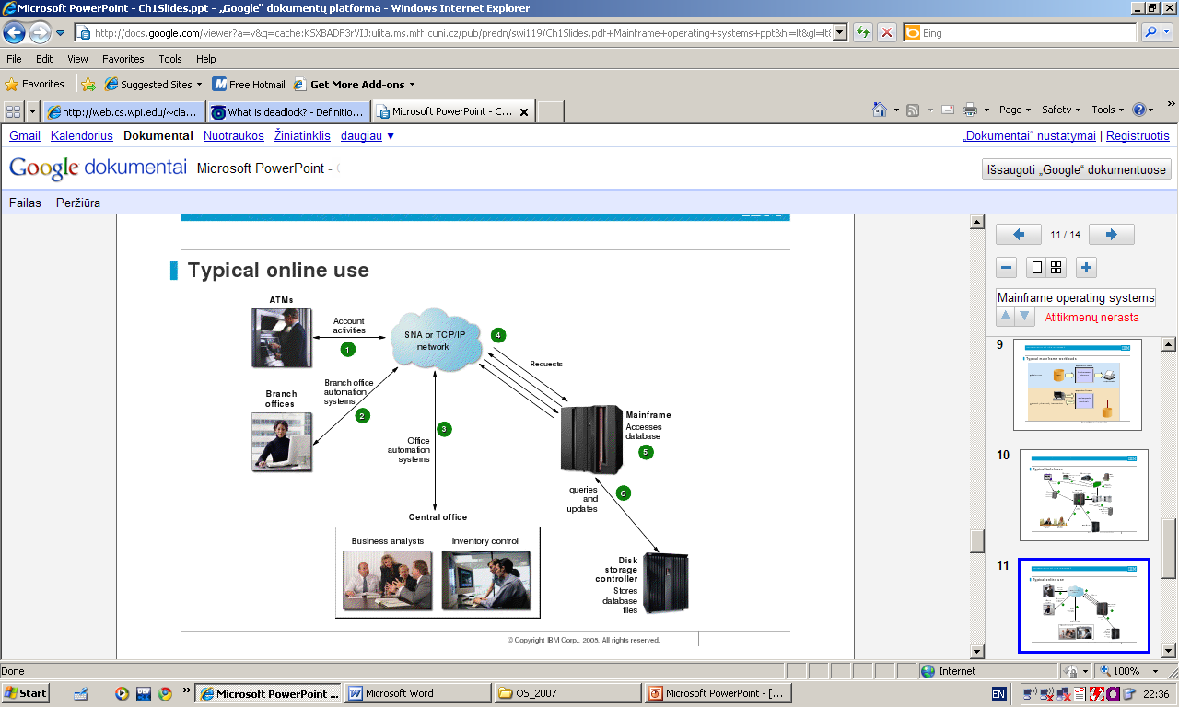
Mainframe operating systems

Slide 12
Mainframe operating systems
z/OS
z/VM
VSE
Linux for zSeries
z/TPF

Slide 13
Server operating systems
They run on servers, which are either very large personal computers, workstations, or even mainframes. They serve multiple users at ones over a network and allow the users to share hardware and software resources
Servers can provide print service, file service, or Web service.
Typical OS: Solaris, FreeBSD, Linux and Windows Server XXX

Slide 14
Multiprocessor operating systems
An operating system capable of supporting and utilizing more than one computer processor.
Below are some examples of multiprocessing operating systems. Linux, Unix, Windows XXX.

Slide 15
Personal computer operating systems
Modern ones all support multiprogramming.
Their job is to provide good support to a single user.
They are widely used for word processing, spreadsheets, and internet access.
OS: Linux , FreeBSD, Windows XXX, MacOS

Slide 16
Handheld Computer operating systems
A handheld computers or Personal Digital Assistant (PDA) is a small is a small computer that can be held in your hand during operation.
Smartphones and tablets are the best-known examples.. Most of these devices boast multicore CPUs, GPS, cameras and other sensors, copious amounts of memory, and sophisticated operating systems.

Slide 17
Embedded operating systems
Embedded systems run on the computers that control devices that are not generally though of as computers and which do not accept user-installed software. Typical examples are TV sets, cards, DVD recorders, Mp3 players.
The main property is your cannot download new application on it, all the software is on ROM.

Slide 18
Sensor node operating systems
Each sensor node is a real computer, with a CPU, RAM, ROM, and one or more environmental sensor. (for forecast, fire detection, movements detection, …)
Users do not suddenly start programs they downloaded from the Internet, which makes the design much simpler. TinyOS well nown os for sensor node.

Slide 19
Real-time operating systems
The systems are characterized by having time as key parameter.
If the action absolutely must occur at a certain moment, we have a hard real-time system (industrial process control, military, … )
Another kind of real-time system is soft real-time system, in which missing an occasional deadline. (digital audio , multimedia system, digital telephones, …)
User can not add their own software…
Real-time system e-Cos

Slide 20
Smart card operating systems
The smallest os run on smart cards, which are credit card-sized devices containing a cpu chip.
Some smart cards are java orientated (ROM holds JVM)

